Slide 1
Structural Equation Model (SEM)- Basics
Peili Fu
12/09/2021

Slide 2
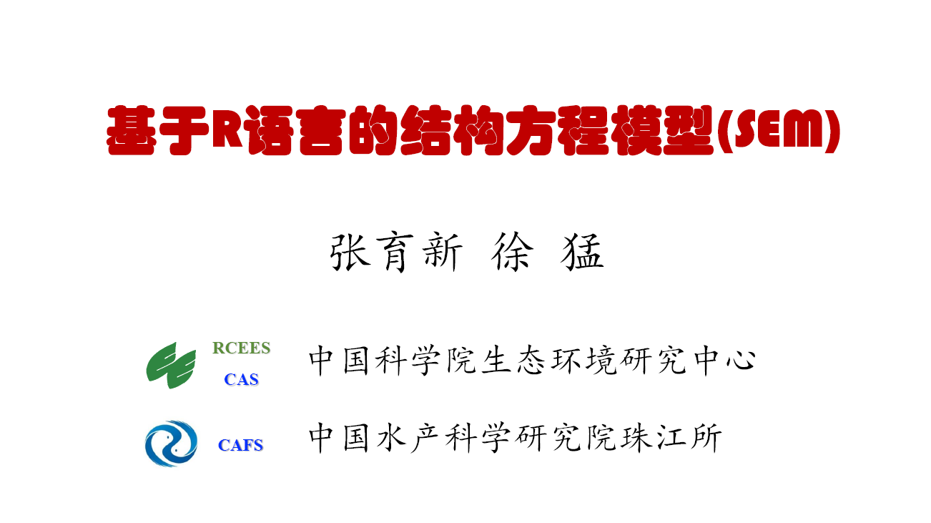
2020.07.20-2020.07.23

Slide 3
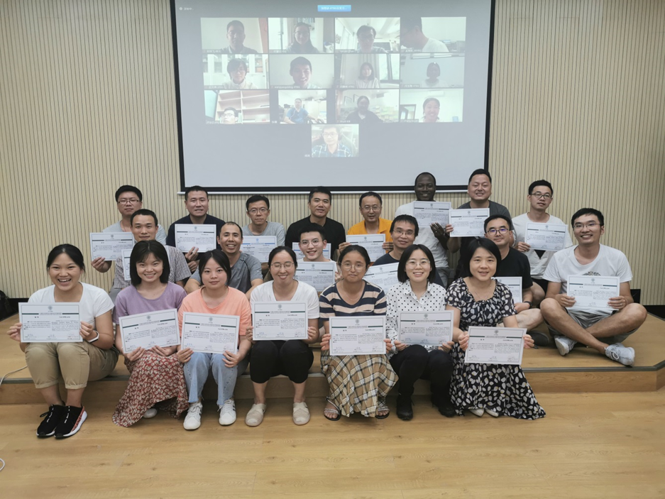
张育新
Yuxin Zhang
徐猛 Meng Xu

Slide 4
Outline of the talk
Introduction of SEM
How can we do SEM in lavaan?
Practice in lavaan.

Slide 5
The definition of SEM
It is a model to construct, assess and quantify the direct and indirect effects in causation relationships networks. At least two independent variables.

Slide 6
Exogenous Variable
Endogenous Variable
Endogenous Variable
Single-headed arrow → Prediction；
Double headed arrow ↔ Correlation；
Direct effect： Regression coefficients of direct prediction
Indirect effect：Mediating effect of x1 on y2 through y1

Slide 7
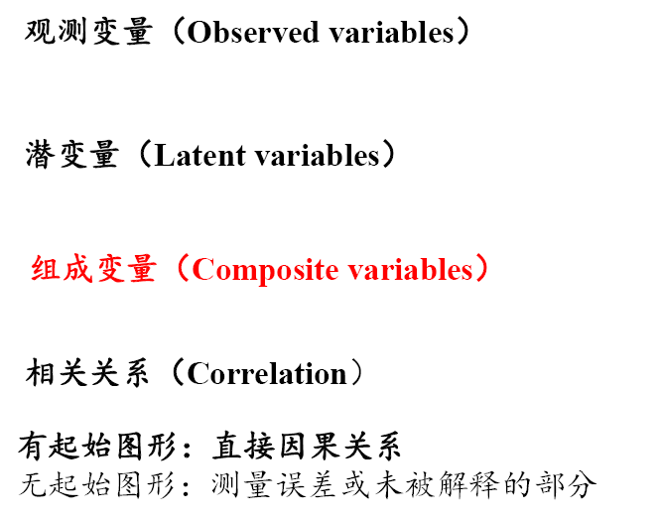

Slide 8
latent variable

Slide 9
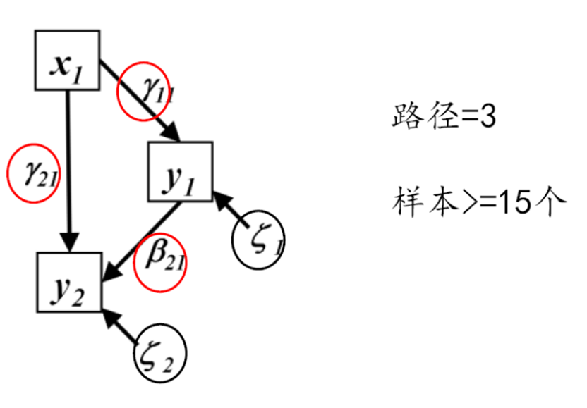
SEM limitations
Biggest limitation is sample size
It needs to be large to get stable estimates of the covariances/correlations
200 subjects for small to medium sized model
A minimum of 10 subjects per estimated parameter
Also affected by effect size and required power

Slide 10
Model test

Slide 12
Global vs. local
Globalestimation:传统上最常用，其不采用原始数据，而是用variance-covariance矩阵。使观察数据的协方差与model-implied协方差最接近，通过最大似然法估计出模型参数。代表软件包lavaan (latent variable analysis)。
Localestimation: 更灵活，其采用原始数据，将SEM破碎化为多个独立的方程，每一个方程对应一个内生节点和他的直接预测者。这些方程可以采用传统上的lm,glm,pgls,lmm,glmm甚至贝叶斯方法开展参数估计。代表软件包piecewiseSEM.

Slide 13
Introduction to lavaan

Slide 14
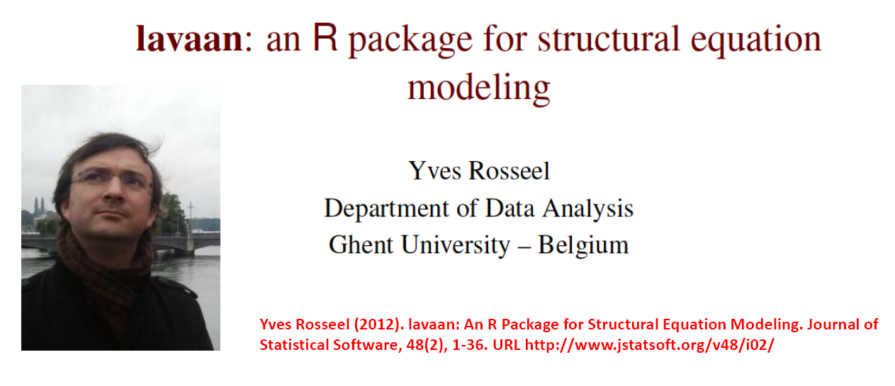

Slide 15
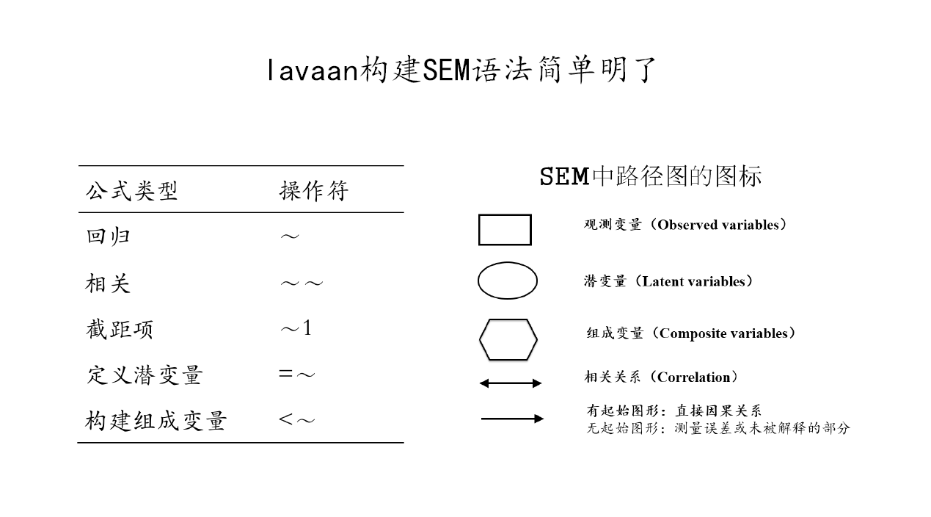
Definition in lavaan

Slide 16
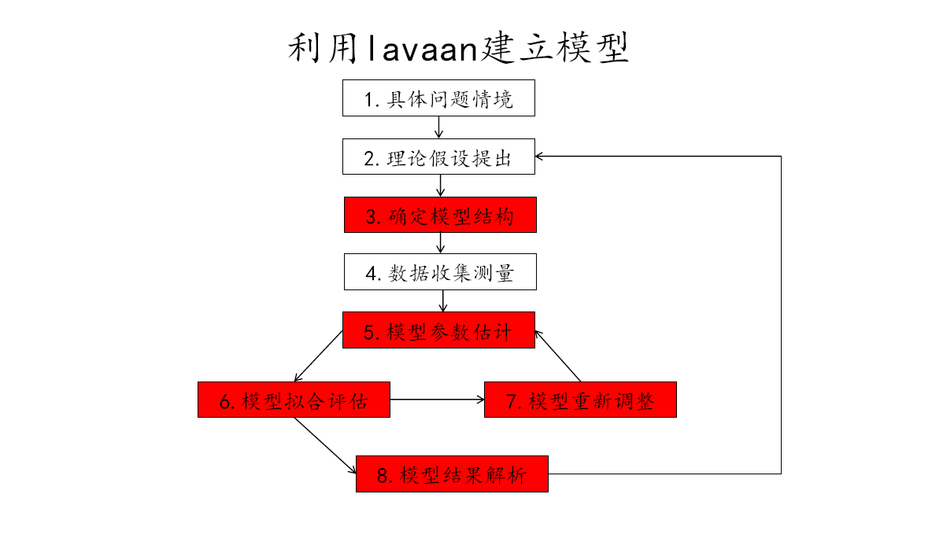
Workflow of lavaan
Questions
Hypothesis and Model
Model analysis test & adjust model
Final results

Slide 17
Example

Slide 19
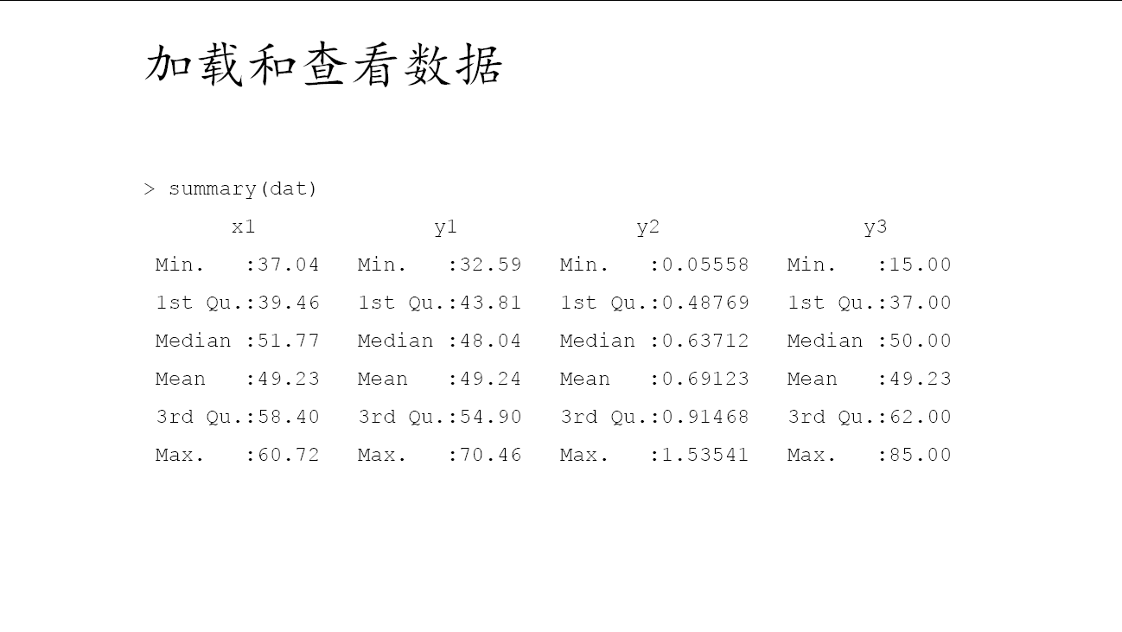

Slide 22
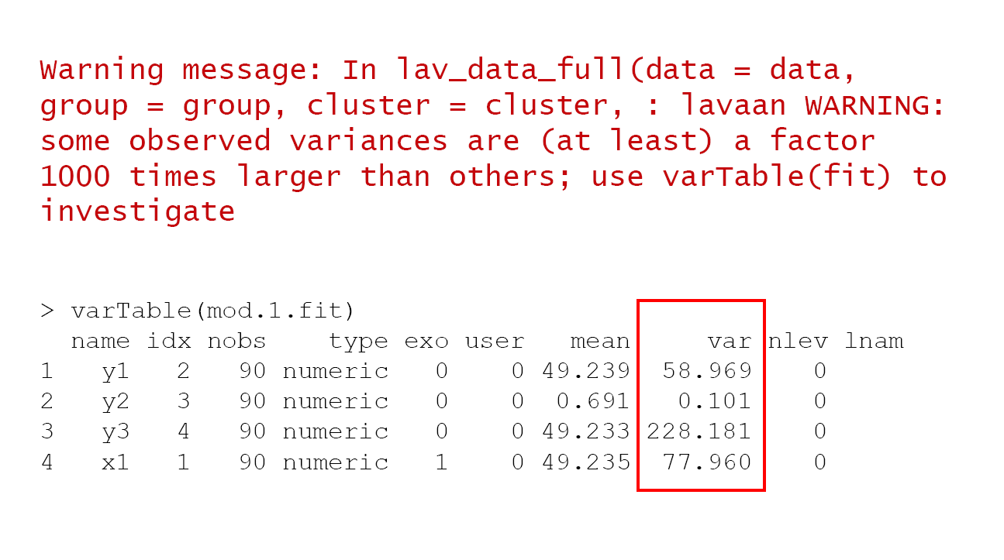

Slide 23
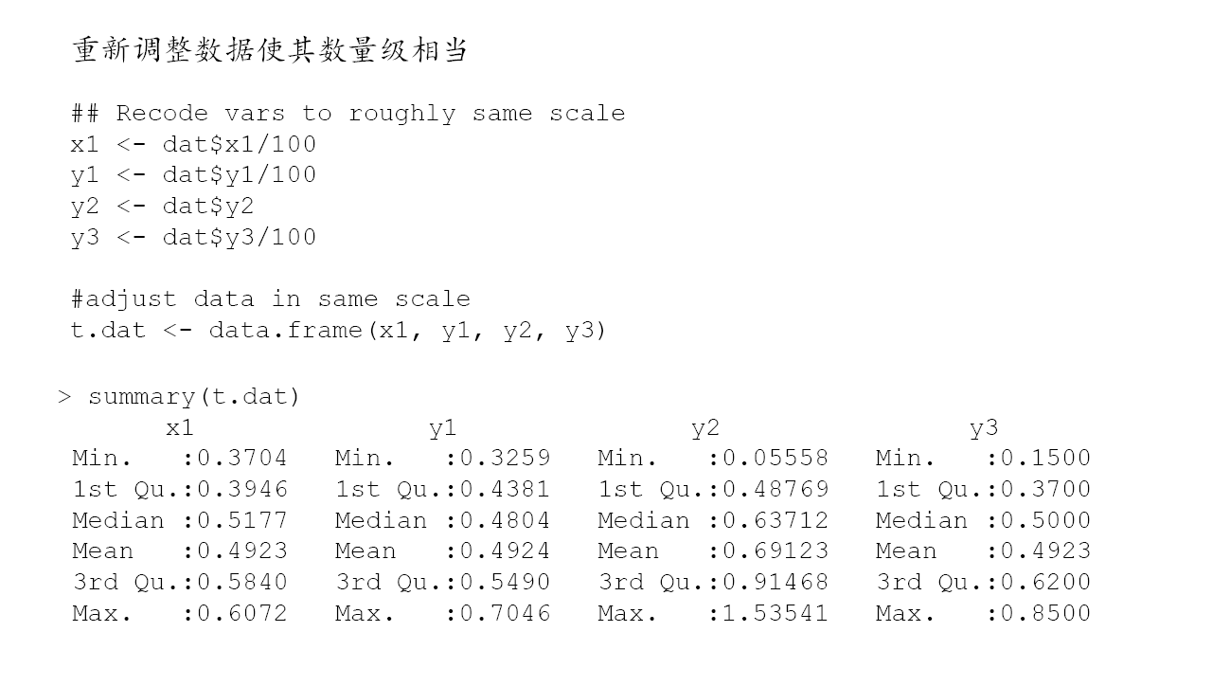

Slide 24
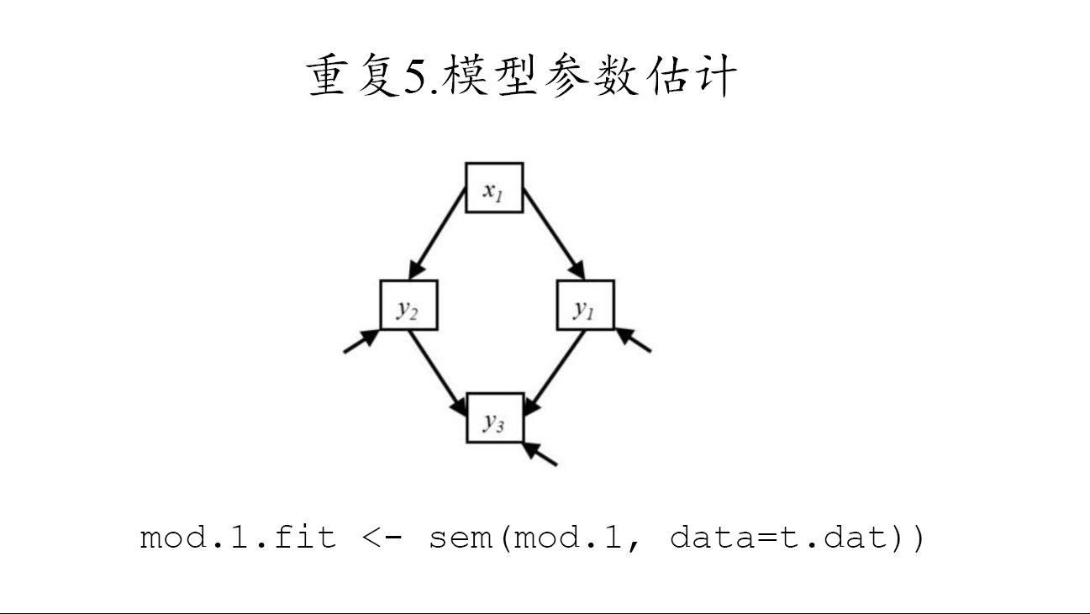

Slide 26
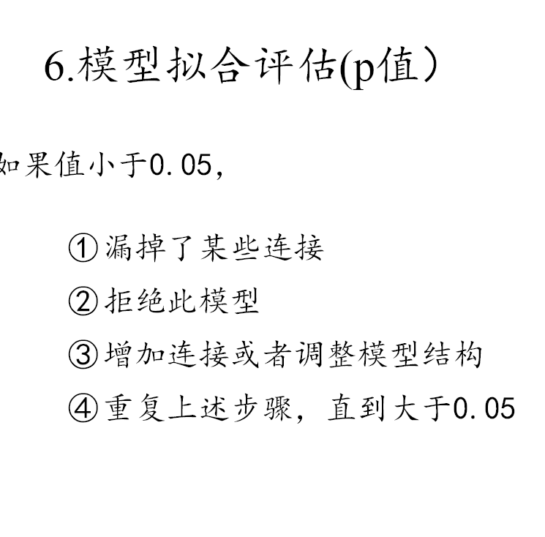
If P is lower than 0.05, indicating that there could be some important pathway that was not included in the model.
We need to re-adjust the model.

Slide 27
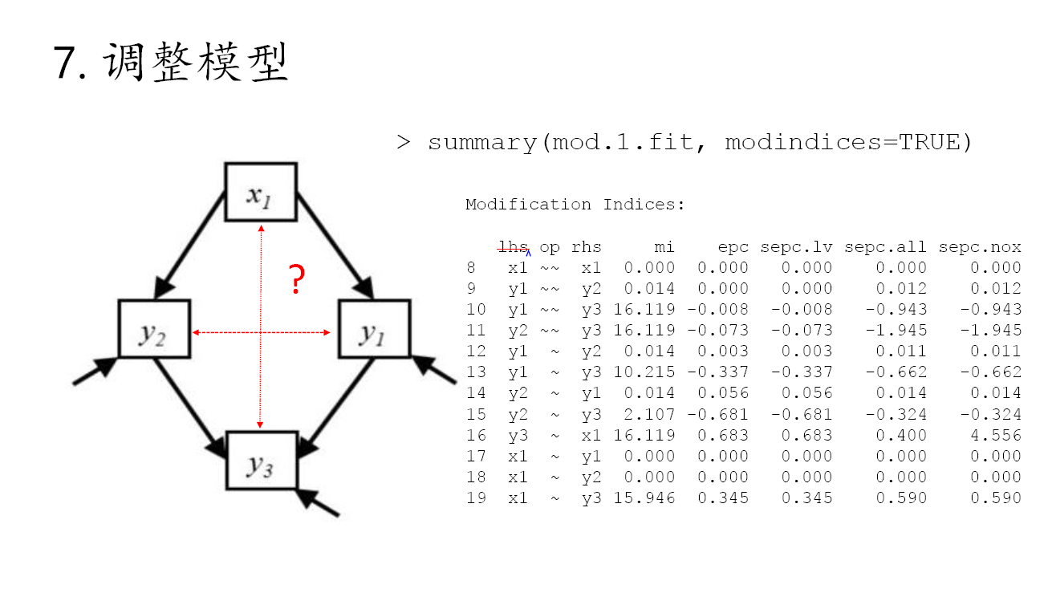

Slide 29
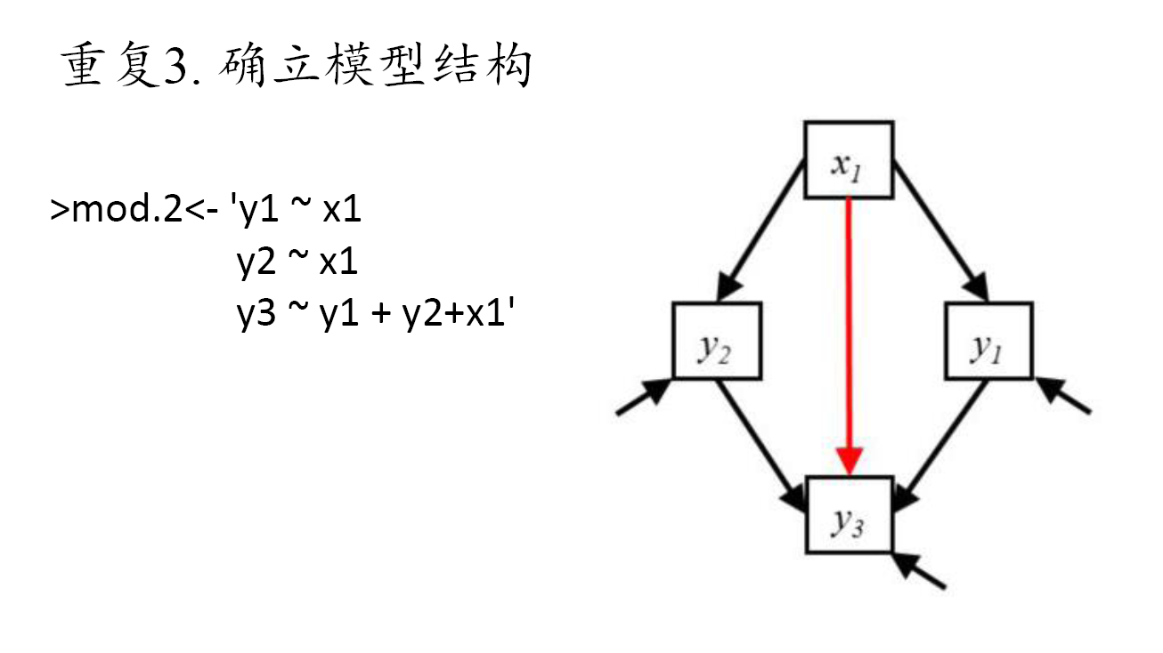

Slide 30
Now the p values is better.

Slide 34
Final output

